Slide 1
GO Team Business Meeting #2
Where we are – Where we’re going

Slide 2
Where We Are
Our strategic plan is the guide for the work we’re doing in the school. By monitoring the plan and ranking priorities, we can all work towards the common goals. Using the priorities in the strategic plan, the school leadership team developed a Continuous Improvement Plan (CIP) for the current school year.

Slide 3
Timeline for GO Teams
You are HERE
1
2
3
4
5
Fall 2021
GO Team Developed 2021-2025 Strategic Plan
Summer 2023
School Leadership completed Needs Assessment and defined overarching needs for SY22-23
August 2023
School Leadership completed 2023-2024 Continuous Improvement Plan
Sept. – Dec. 2023
Utilizing current data, the GO Team will review & possibly update the school strategic priorities and plan
Before Winter Break
GO Team will take action (vote) on the rank of the strategic plan priorities for SY24-25 in preparation for budget discussions.

Slide 4
Discussion Items
Current Strategic Plan
Continuous Improvement Plan
Needs Assessment
SMART GOALS
Action Plan
Strategic Plan Alignment & Update
MAP Data
Data Protocol

Slide 5
Current Strategic Plan
2021-2025

Slide 6
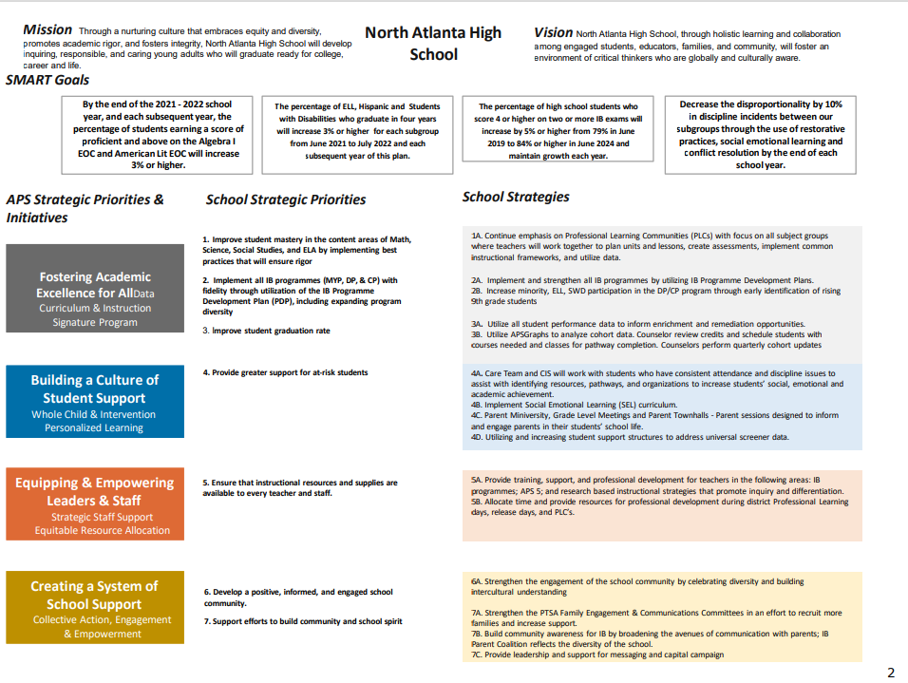

Slide 7
Continuous Improvement Plan

Slide 8
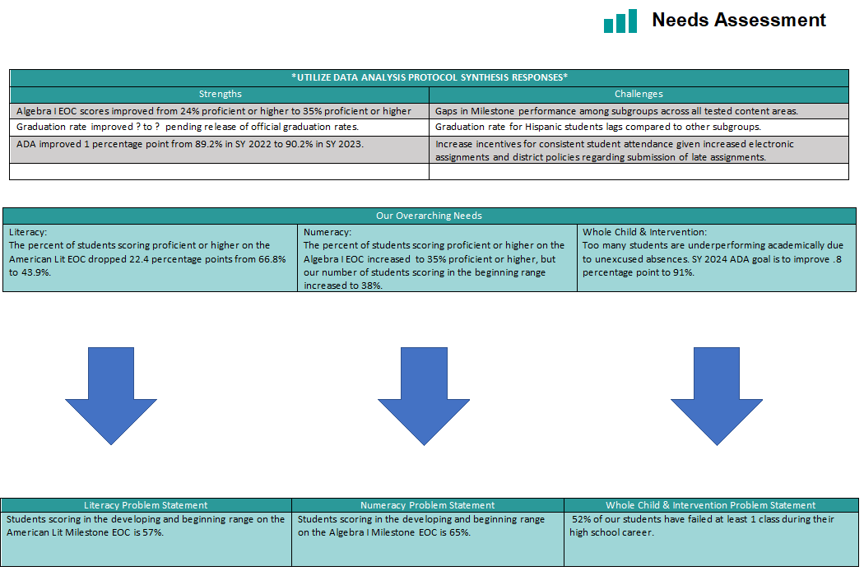
School Name
Needs Assessment
Strengths | Opportunities/Challenges
Our Overarching Needs
Literacy: | Numeracy: | Whole Child & Student Support
Jamboard Link Here
Literacy Problem Statement | Numeracy Problem Statement | Whole Child & Student Support Problem Statement
Notes:
Notes for School CIP Teams: After completing your Comprehensive Needs Assessment ( data protocol), you will come here and identify some strengths and opportunities/challenges you have observed from the data. The priority areas are Literacy, Numeracy, and Whole Child & Student Support. Identify an overarching need for each area. Formulate a problem statement for each area. Make sure the problem statement meets the criteria. Refer to your CIP resources.

Slide 9
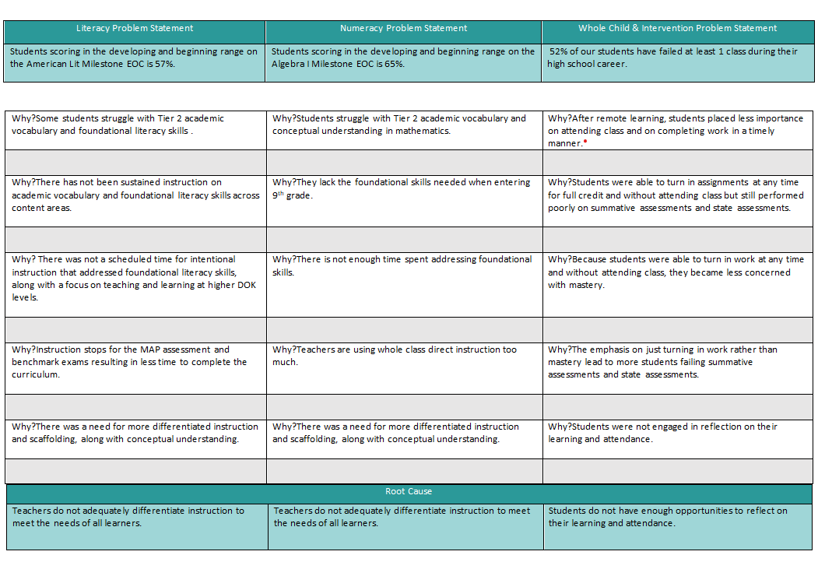
School Name
Needs Assessment
Strengths | Opportunities/Challenges
Before Presenting to
your GO Team:
Insert Your Needs Assessment
(use as many slides as necessary)
Our Overarching Needs
Literacy: | Numeracy: | Whole Child & Student Support
Jamboard Link Here
Literacy Problem Statement | Numeracy Problem Statement | Whole Child & Student Support Problem Statement
Notes:
Notes for School CIP Teams: After completing your Comprehensive Needs Assessment ( data protocol), you will come here and identify some strengths and opportunities/challenges you have observed from the data. The priority areas are Literacy, Numeracy, and Whole Child & Student Support. Identify an overarching need for each area. Formulate a problem statement for each area. Make sure the problem statement meets the criteria. Refer to your CIP resources.

Slide 10
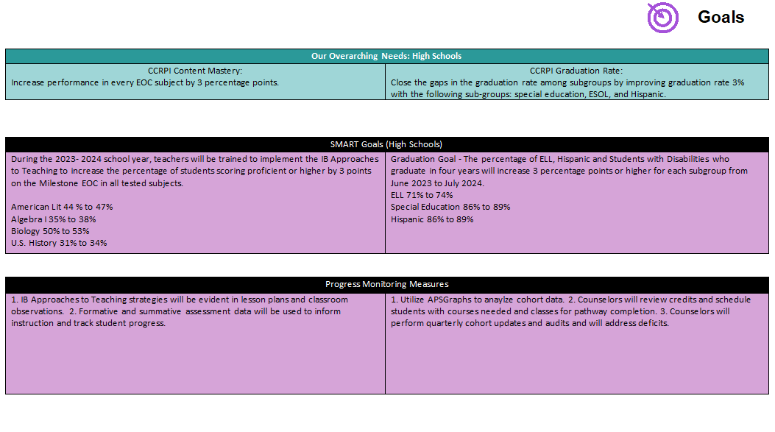
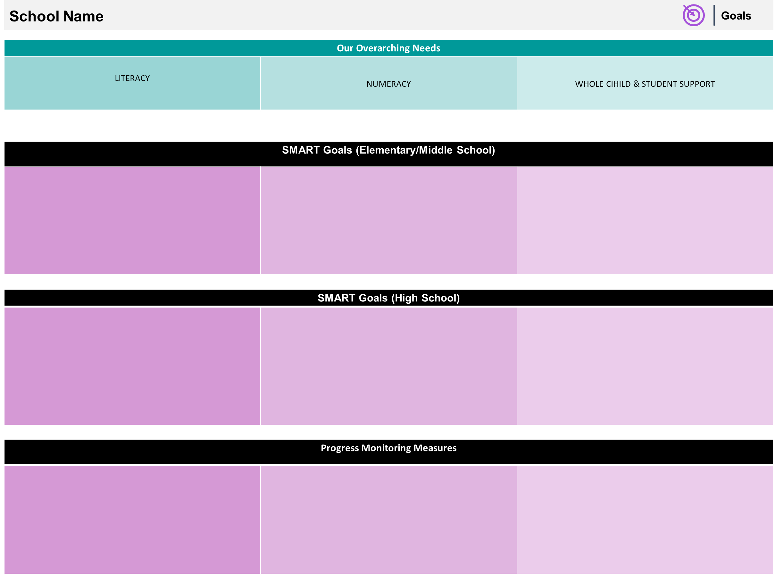

Slide 11
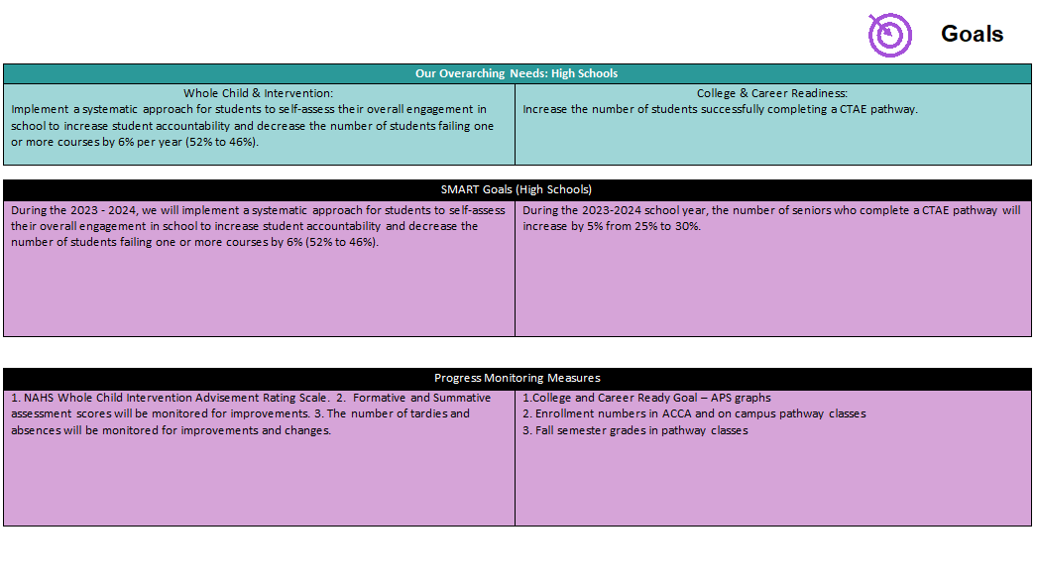

Slide 12
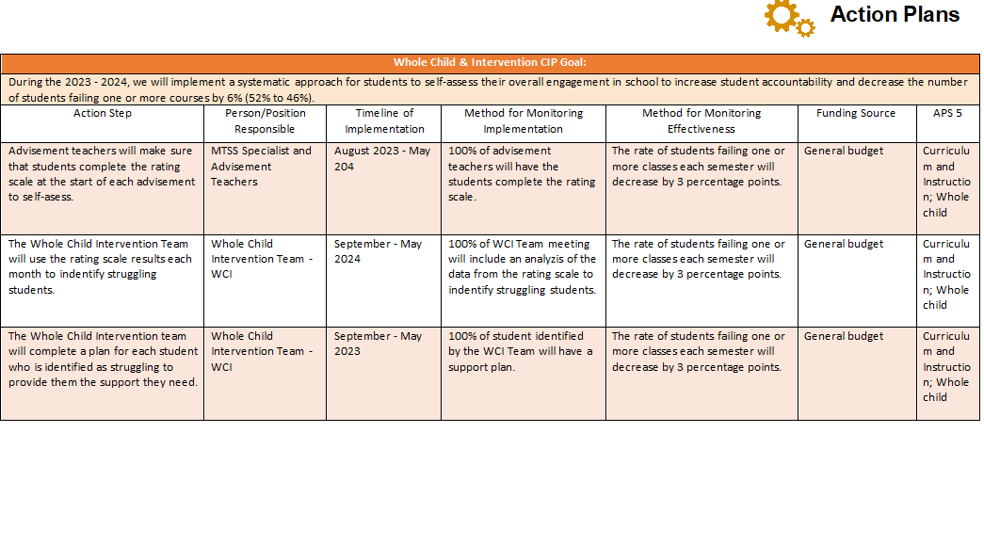
Before Presenting to
your GO Team:
Insert Your Action Plan
(use appropriate format)

Slide 13
Before Presenting to
your GO Team:
Insert Your Action Plan
(use appropriate format)

Slide 14
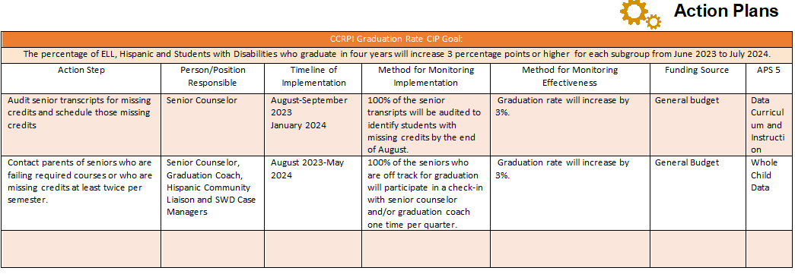

Slide 15
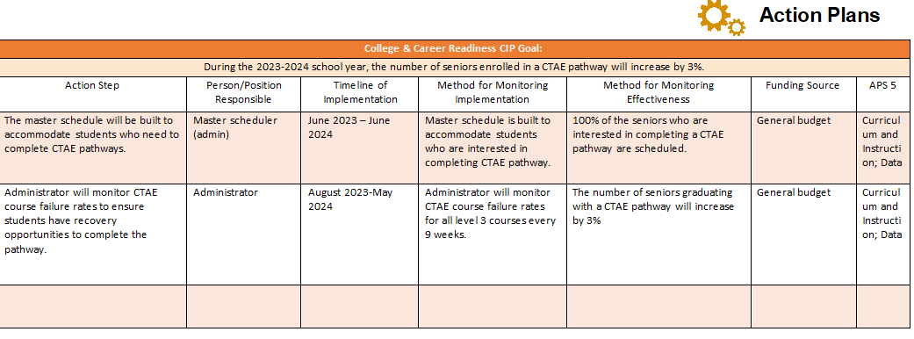
Before Presenting to
your GO Team:
Insert Your Action Plan
(use appropriate format)

Slide 16
GO Team Activity & Discussion
GO TEAM DISCUSSION: Review the priorities and goals in your strategic plan and the information and goals CIP. Reflect on if updates need to be made to the Strategic Plan.
Are all CIP Goals reflected in
our Strategic Plan Priorities?
If not, which CIP Goal(s) are missing and should be added to the Strategic Plan?

Slide 17
Updates to the
Strategic Plan
Enter all changes/updates to your plan – be sure to include accountability measures, as appropriate.

Slide 18
MAP Data

Slide 19
SPRING MAP Results

Slide 20
FALL MAP RESULTS

Slide 21
GO Team Discussion: Data Protocol
What do you notice?
What are your wonderings?
What additional questions do you have?

Slide 22
Strategic planning will help you fully uncover your available options, set priorities for them, and define the methods to achieve them.
Robert J. Mckain

Slide 23
Where we’re going
At our next meeting(s) we will discuss how our data is aligning to our strategic plan and determine if we need to make any adjustments.
Before the end of Fall Semester, we will take Action (vote) on ranking our strategic priorities for the 2024-2025 school year.
Let me or the Chair know of any additional information you need for our future discussion.

Slide 24
Thank you

